Slide 1

Prediction of Household sales price Using Linear Regression
Presented by-
Naveen Mechu

Slide 2
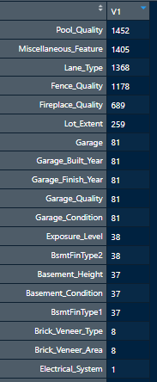


Data Description
Our goal for this project was to use linear Regression technique to predict/estimate the sale price of house.
Missing Values
Data set have 81 variables and 1459 observations. 80 explanatory variables describes almost every aspect to predict sale price.
Okay, will ignore variables having more missing values and use KNN to remove where missing values are less

Slide 3
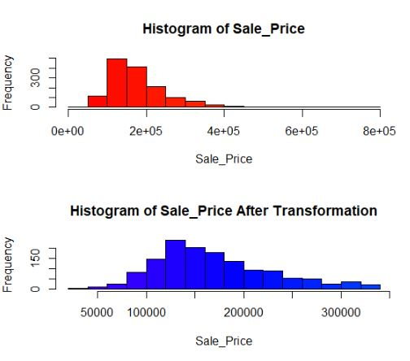
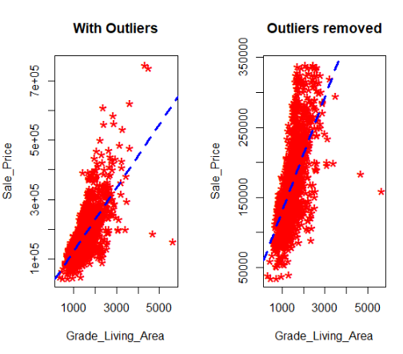

Data Cleaning
After Cleaning

Slide 4
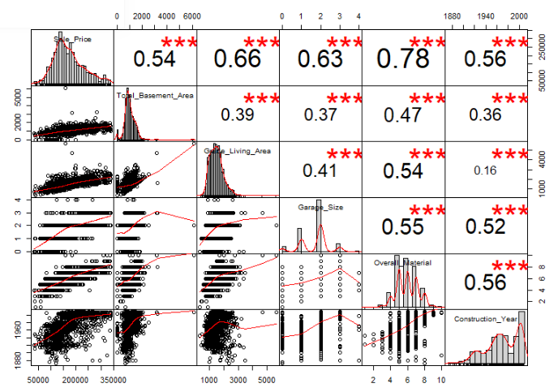
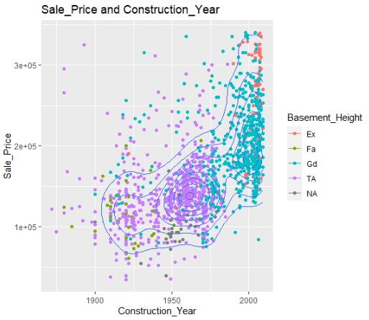


Variables Correlation
all variables are positively correlated
Scatterplot between Sale_Price and Construction_Year shows Sale_Price Increases with increase in construction year and Basement heights of houses is also increasing

Slide 5
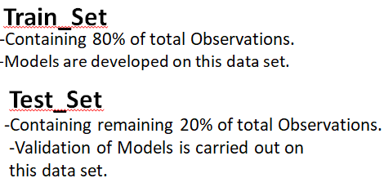
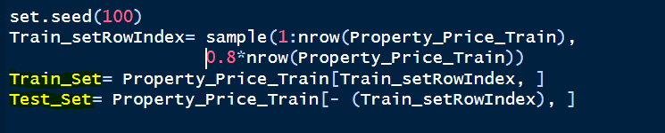

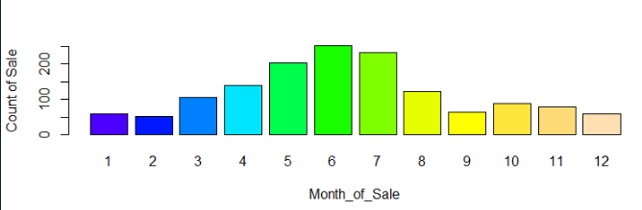

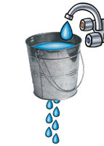
Data Processing
train dataset
Barplot just for fun
Test dataset predictions

Slide 6

Selection of variables for Models
We have selected 5 Independent and 1 dependent variables for Model 1 and 3 Independent and 1 Dependent variable for Model 2. We screens variables based on correlation coefficients with Sales_Price and amount of variability explained by the model(R-Square).
Model 1
Model 2
Dependent Variable | Independent Variables
Sales_Price | 1. Overall_Material
 | 2. Total_Basement_Area
 | 3. Grade_Living_Area
 | 4. Garage_Size
 | 5. Construction_Year
Dependent Variable | Independent Variables
Sales_Price | 1. Grade_Living_Area
 | 2. Total_Basement_Area
 | 3. Overall_Material
Model2 R-Square | 0.728
Model1 R-Square | 0.776

Slide 7

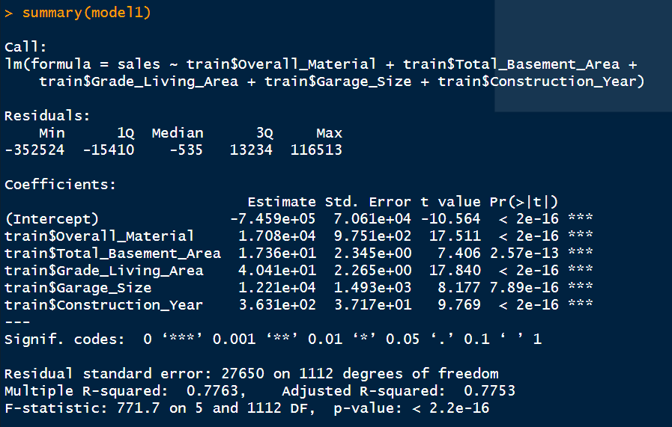


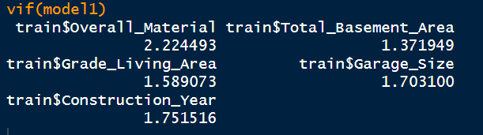


Prediction using Model 1
RMSE Value | 81282.09

Slide 8

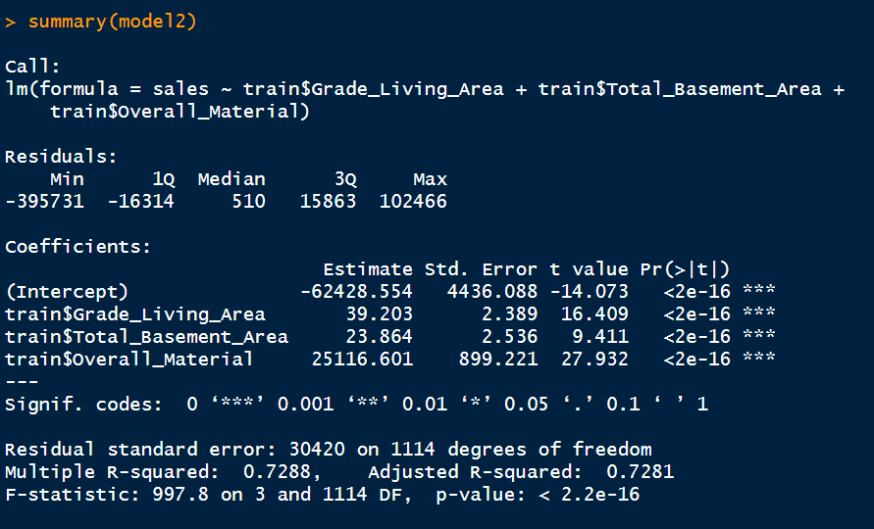


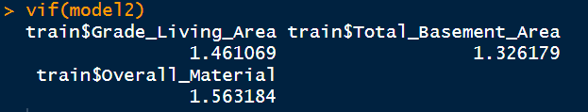


Prediction using Model 2
RMSE Value | 80611.54

Slide 9
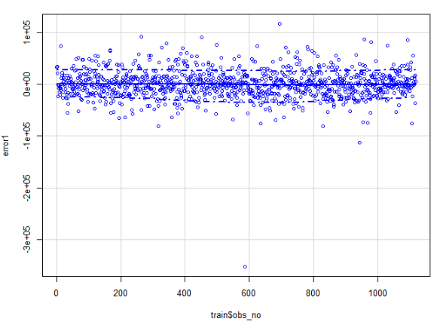
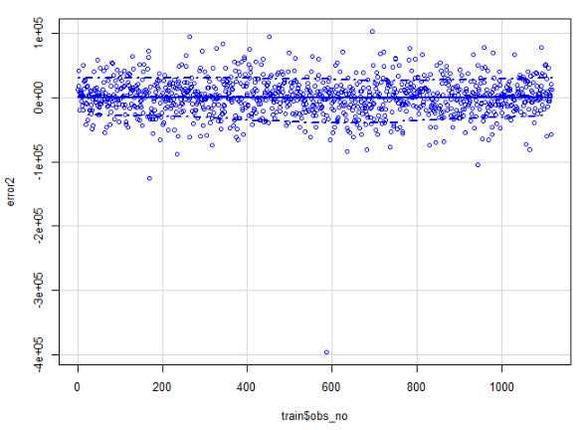
Assumptions
Error while using Model 1
Error while using Model 2
Scatter Plot of Errors using Model1 and Model2 shows both model follows- Normality, Linearity, Independence of Error and Constant of variance.
Conclusion
Both presented Models for predicting Sales_Price of houses are good and will give more scientific approach to predict.

Slide 10


